Slide 1
AddMvc() vs AddMvcCore()
Sarita Lad
DATE

Slide 2
AddMvcCore()
AddMvcCore() , as the name implies, only adds core components of the MVC pipeline, requiring you to add any other middleware (needed for your project) by yourself.
AddMvc is the way your application says that you want the MVC services available to the system (needed in order for UseMvc ) to work correctly

Slide 3
AddMvcCore Method
AddMvcCore() calls only add the core methods :
Adding this method enables the minimum dependency required to run the MVC framework. It adds essential MVC services to the specified method.
What is in this method?
ApplicationPartManager Manages the parts and features(list of controllers) of an MVC application.
DefaultFeatureProviders Adds the controller feature providers
Default services Adds the routing
CoreServiecs These are the basic services to run the MVC framework with minimum dependencies.

Slide 4
AddMvc Method
AddMvc internally calls internally AddMVCCore() methods
MvcCore - This is the core dependency of MVC framework . These are the minimum dependencies required to run the MVC framework. The list of below features will not be available in this method.
ApiExplorer - This enables the API help pages
Authorization - Middleware for security and authorization of web apps.
DefaultFrameworkParts - This adds some application part dependencies. Application part manager takes care of application parts and application features.
FormatterMappings - A filter that will use the format value in the route data or query string to set the content type on an Object Result.
Views - This enables the Views feature and makes it work.
RazorViewEngine - Parser and code generator for CSHTML files are used in View pages for MVC web apps.
RazorPages - Razor Pages is a new feature of ASP.NET Core MVC that makes coding page-focused scenarios easier and more productive.
CacheTagHelper - Tag Helpers enable server-side code to participate in creating and rendering HTML elements in Razor files
DataAnnotations - Data annotations enable validations and decorates the model.
JsonFormatters - This enables the JSON data formatters .
Cors - This enables the Cross-origin resource sharing (CORS), which is a mechanism that allows restricted resources .

Slide 5
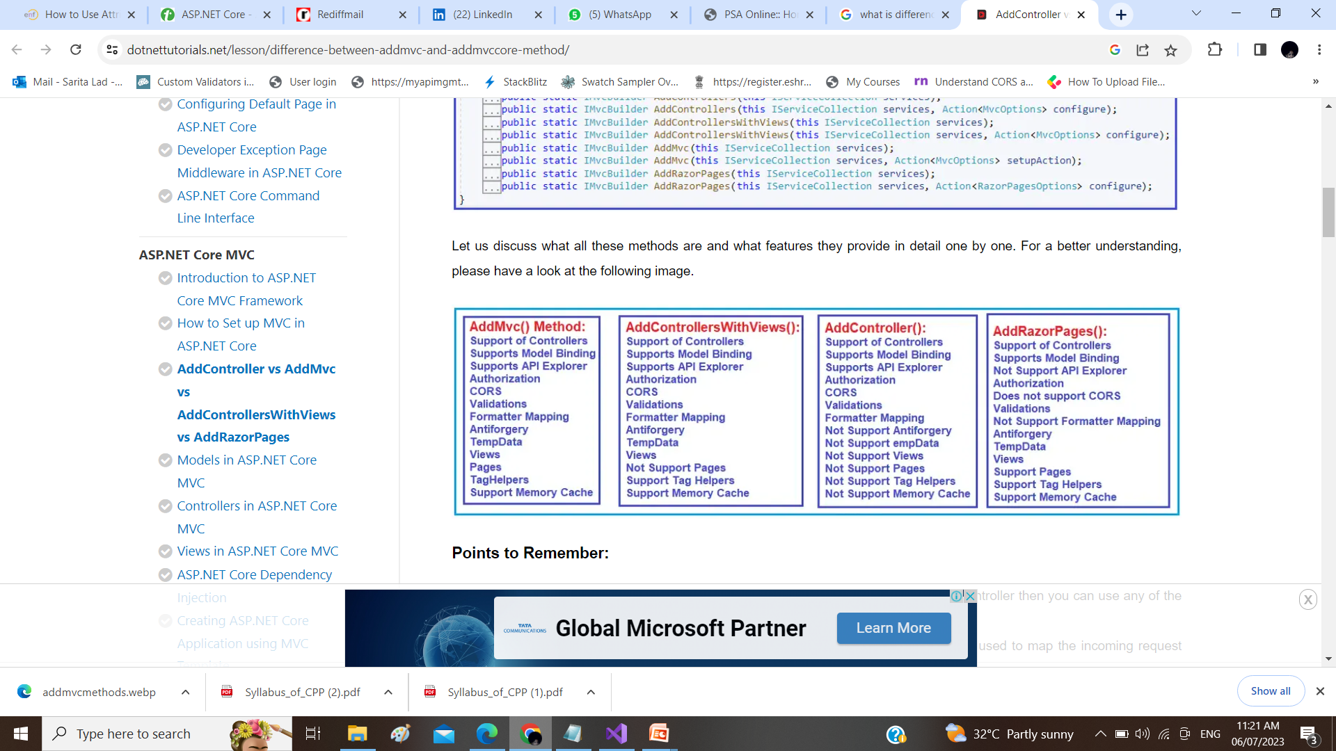

Slide 6
Thank You

